Slide 1
Introduction:
Inventory is a physical resource that a firm holds in stock with the intent of selling it or transforming it into a more valuable state.
Inventory System is a set of policies and controls that monitors levels of inventory and determines what levels should be maintained, when stock should be replenished, and how large orders should be.
There are many items in a departmental store, which are sold to customers and purchased from suppliers. An order is placed by the customer-required details , which are listed below: Item name Quantity Delivery time
The order processing executes, look up the stock of each item available or not then order is fulfilled by the management of departmental store
The system periodically checks the store stock of each item if it is found below the reorder level then purchase order is placed to the supplier for that item, if the supplier is not able to supply whole order then rest of quantity is supplied by another supplier.

Slide 2
After fulfilled the formalities, a bill is generated by the system and send to the customer.
•Item details are maintained by the management and this whole process is done manually. Our work area is to automate the above process and to generate more efficient system
Inventory is the term for the goods available for sale and raw materials used to produce goods available for sale. Inventory represents one of the most important assets of a business because the turnover of inventory represents one of the primary sources of revenue generation and subsequent earnings for the company's shareholders.
Inventory management is a step in the supply chain where inventory and stock quantities are tracked in and out of your warehouse.
An inventory management system is a tool that allows you to track goods across your business's supply chain. It optimizes the entire spectrum spanning from order placement with your vendor to order delivery to your customer, mapping the complete journey of a product.

Slide 3
Smart Inventory Management System is an online software application which fulfills the requirement of a typical Stock Analysis in various go downs.
Keeping track of all the items of a store without the help of a software is a tedious and unnecessary work on this era in which technology makes a difference, within failure and success.

Slide 4
It provides the interface to users in a graphical way to manage the daily transactions as well as historical data.
Inventory management referred to be the process of handle inventory with care primarily to meet the demand in the market at the right time with reduced cost as well as with low investment.

Slide 5
Problem statement:
For any business inventory is one of the most important department that must be well managed in order to run daily business activity smoothly. But mostly business are not able to manage inventory as they do not have good computerized system.
Inventory management is one of the basic problems for a company .it may cause a lot of paperwork , if there is no automated system available.
To provide the basic services related to the Supply of the items, to maintain their Supply Order and details. The product will take care of all the supply orders, purchased, sold and stored. It is concern to keep the records of each Supply Order, which is received, from firm, supplying products. These products are then assigned a unique number given by Mega mart, further they are supplied to different branches. The reference of Last Purchase Price of the product is maintained to form the transaction sheet of the particular purchase or sold items.

Slide 6
The process of manually looking for the inventory available in stock is reallytime consuming and cumbersome that includes the person responsible to seehow many materials are in the inventory , how many materials have beenordered and received and keep the record of the time that will take for thesuppliers to process orders and other various tasks included in inventory

Slide 7
Solutions
the inventory management system will solve the problems as everything about the inventory will be stored in a database which will be much easier to marinating and update and this will also save time and cost effective for the organization and will automate many inventory related tasks.
Inventory management software: Implement dedicated inventory management software to automate tasks, streamline processes, and eliminate the need for manual paperwork. These software solutions can track inventory levels, generate purchase orders, manage stock locations, and provide real-time data for informed decision-making.
Standardize inventory processes: Develop and implement standardized procedures for receiving, storing, and tracking inventory. This ensures consistency and reduces the risk of errors or misplaced paperwork.
Regular inventory audits: Conduct regular inventory audits to identify discrepancies and ensure data accuracy in your system, whether manual or automated.
Invest in training: Train your staff on the new inventory management system or processes to ensure they understand how to use it effectively and minimize reliance on paper-based methods.

Slide 8
Barcode Scanners and RFID Tags:
Utilize barcode scanners for faster and more accurate data entry of products entering or leaving your warehouse.
Implement Radio Frequency Identification (RFID) tags on your products. RFID tags can store more data than barcodes and enable real-time tracking of inventory movement throughout your supply chain.
Barcode Scanners and Inventory Management Software:
Implement barcode scanners for faster and more accurate data entry.
Integrate barcode scanners with inventory management software to eliminate manual data input and reduce errors.
Leverage the software to track inventory levels in real-time, automate reorder points, and generate reports for better decision-making.
Mobile Inventory Management Apps:
Use mobile inventory management apps for on-the-go stock updates and real-time data access.
Conduct cycle counts and physical inventories more efficiently.
Improve warehouse and overall operational efficiency.

Slide 9
OBJECTIVES
Implement real-time inventory tracking to ensure precise data on stock levels across all locations.
Automate manual inventory processes like receiving, picking, and shipping to enhance accuracy and speed.
To keep material cost under control as they contribute to reducing the cost of production
To eliminate duplication in ordering stocks.
To supply the required material continuously
To maintain the availability of materials whenever and wherever required in enough quantity
To avoid both overstocking and under-stocking of inventory.

Slide 10
Literature Survey
Title of the work: “Inventory Management System”
Authors: Shreyas Borwankar *1
Description: This рарer hаs рresented аn inventоry mаnаgement system, the dаtаbаse needs tо be uрdаted every dаy оr befоre inventоries sо thаt new eligible dаtа mаy be enrоlled аnd thоse whо аre useless аre remоved frоm the dаtаbаse

Slide 11
Literature Survey
Title of the work: “Design and Implementation of Inventory Management System for University”
Authors: Santosh Soni, Pankaj Chandra, Akanksha Gupta, Deepak Kant Netam, Sushant Kumar, Kaushik Tiwary
Description: This paper aims to develop a web-based application project for the finance department of a college using HTML, Bootstrap, CSS, JavaScript, PHP, Ajax, and SQL

Slide 12
Literature Survey
Title of the work: “Inventory Management System”
Authors: Ankitha Venkatesh1 , Kiran Kumar M N2
Description: an inventory management system is a crucial tool for businesses to track, organize, and control their inventory effectively

Slide 13
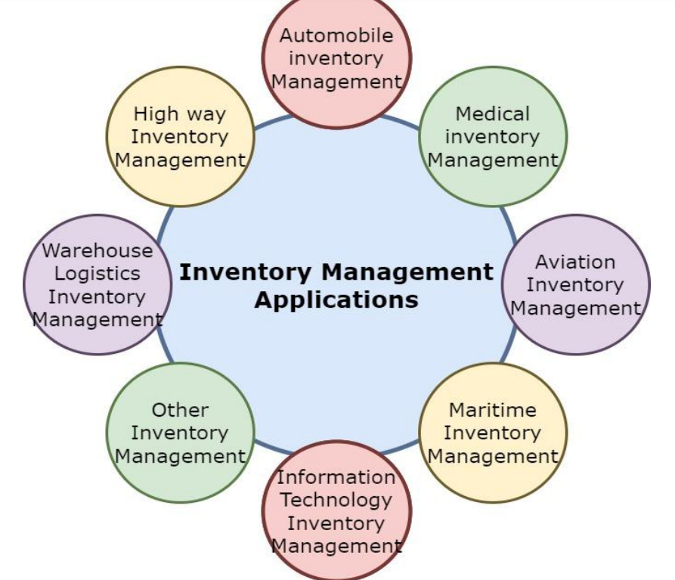
Applications of Inventory Management

